Slide 1
Work Plans
420-E31 Systems III

Slide 2
Developing Work Plans
A work plan, is a dynamic schedule that records and keeps track of all tasks to be accomplished over the course of the project
Created after a project manager has a general idea of the project’s size and rough schedule
The work plan is usually the main item in a project management software application, e.g. Microsoft Project

Slide 3
Developing a Work Plan
Identify tasks in the project
Estimate task length
Determine task dependencies
Assign resources to tasks

Slide 4
Example of a Work Plan Task
Work Plan Information Example
Name of task Perform economic feasibility
Start date Jan 05, 2014
Completion date Jan 19, 2014
Person assigned Mary Smith, sponsor
Deliverable(s) Cost-benefit analysis
Completion status Open
Priority High
Resources needed Spreadsheet
Estimated time 16 hours
Actual time 14.5 hours
Notes:
This is the basic information. Most s/w packages allow a lot of other things.
What are some important things that are missing?
Cost (estimated and actual)
Planned vs. actual
Last update

Slide 5
How to Identify Tasks
Top-down approach
Identify highest level tasks as phases in the project
Break them into increasingly smaller units
Methodology
Using standard list of tasks
Similar previous projects
Work Breakdown Structure (WBS)
Hierarchical structure used to organize tasks for reporting schedules and tracking costs
Notes:
Standard lists from PMI and other places
Similar projects is just experience

Slide 6
How to use Work Breakdown Structure (WBS)
Specify high level tasks
Break down each step into smaller tasks and number them in a hierarchical fashion
WBS can be done in two ways
SDLC phase
Product
Notes:
Start with phases: Inception, Elaboration, Construction, Transition or maybe Planning, Analysis, Design & Implementation
Develop a website: One thing that happens during Inception is Feasibility Analysis
Broken down further to Technical, Economic, Organizational (Operational here)
Organizational broken down to Political & Functional
Could break it down by product/deliverable
Applets, Servers, public pages, client pages, etc.
Servers – database and application

Slide 7
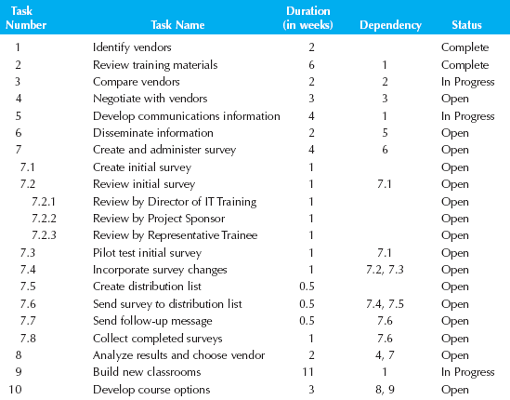
Work Breakdown Structure Example

Slide 8
WBS Problems
They tend to be specific to the design of the information system being developed.
Too many levels of detail too early on in the SDLC for large projects or too few for small projects.
Since they are project specific, they are difficult to compare across projects.

Slide 9
Evolutionary WBS
Organize in a standard manner across all projects (workﬂows, phases, then specific tasks)
Create in an iterative and incremental manner
First evolutionary WBS done with initial aspects of the project, high level items
Later on more details are added to the WBS, low level items
Comparable to earlier projects based on cost and schedule estimation
Notes:
Becoming most common way of doing things
Use RUP workflows as primary areas of breakdown

Slide 10
Managing WBS: Project Work Plan
Mechanism used to manage the tasks in the WBS
Check to see if ahead or behind schedule, changes needed
Table that lists all the WBS tasks, people assigned, variances, dependencies
Identify milestones
Notes:
Go back to example and show the dependencies between tasks

Slide 11
Tools & Techniques
Gantt Chart
Developed by Henry Gantt in 1917
A horizontal bar chart used to depict project tasks against a calendar
PERT Chart
Project Evaluation & Review Technique
A graphical network model used to depict the interdependencies between a project’s tasks

Slide 12
Gantt Chart
Tasks listed in rows
Time listed in columns
Can be rolled up into any increment depending on audience
Draw horizontal bars to represent duration of each task
Fill in bars as tasks are worked on
Link task dependencies by drawing an arrow between them

Slide 13
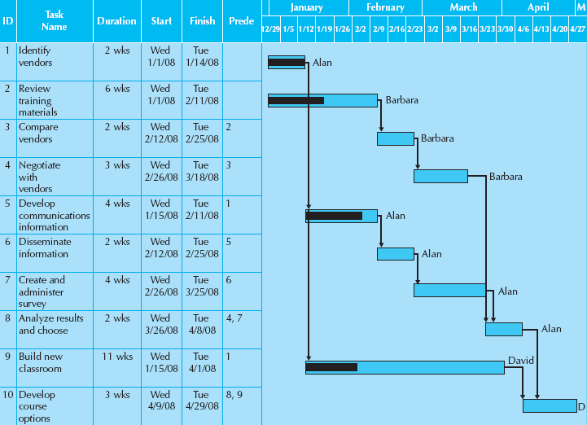
Gantt Chart

Slide 14
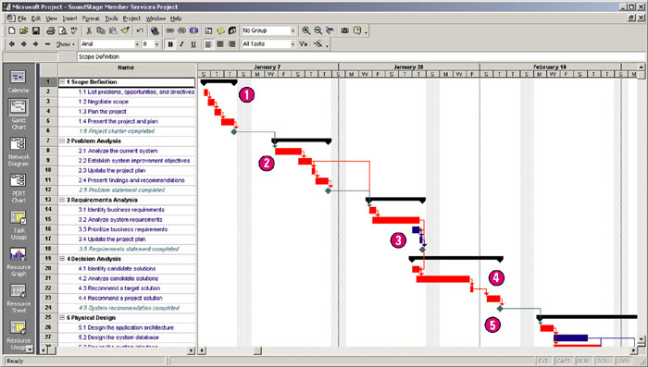
MS Project Gantt Chart
Notes:
Common notations
1 – summary tasks – tasks that are further decomposed into other tasks
2 – critical tasks (red) – delay to these tasks delays whole project
3 – not critical (blue) – have slack time
4 – arrows indicate pre-requisites
5 – milestones (diamonds)

Slide 15
PERT Charts
Another graphical representation
Lay out tasks like a flowchart
Identify task information in box
Draw lines to show dependencies
Allows easier visualization of tasks on a critical path – tasks that must be completed on time in order for project to finish on time

Slide 16
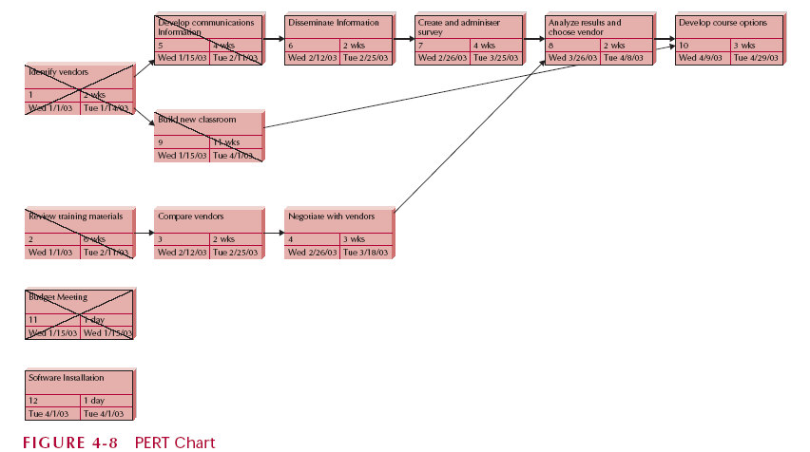
PERT Chart Example

Slide 17
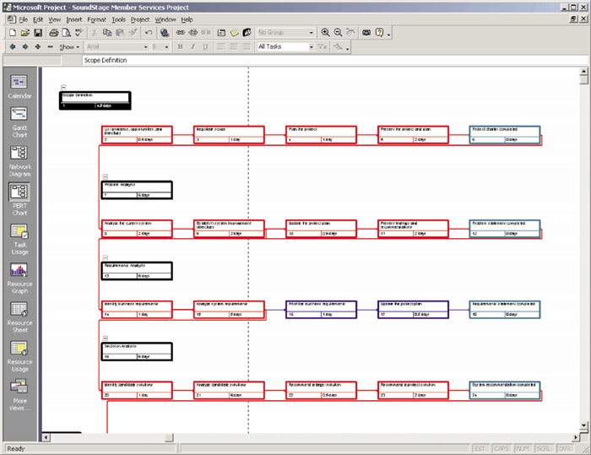
MS Project PERT Chart
Notes:
Which one is better, PERT or Gantt chart?
PERT – show dependencies very well; used for Critical Path Method that we will get to later
Gantt – More practical, more information and more time relative (no time in PERT Chart)
One benefit to using software is that it will allow you to switch views

Slide 18
Which is Better, PERT or Gantt Chart?
PERT – show dependencies very well; used for Critical Path Method that we will get to later
Gantt – More practical, more information and more time relative (no time in PERT Chart)

Slide 19
Tasks: Adding and defining
Top-Down approach
Start a highest level
Systematically develop increasing level of detail
Bottom-Up approach
Start at lowest level task
Aggregate into summaries and higher levels
No one best way, but experienced PM’s generally use Top-Down
Notes:
Why use top down?

Slide 20
Types of Tasks
Summary Tasks
Grouping of tasks within a logical structure
Nouns, e.g. Inception Phase, Detailed Design
Detail Tasks
Any task that is not further broken down; also called Primitive Tasks
Use present tense to indicate action, e.g. develop prototype

Slide 21
Project Scheduling in MS Project
Three Scheduling Techniques:
Scheduling Formula
Duration = Work ÷ Resource Units
Can control which value has the most influence on schedule
Task Types
Settings for tasks to control the way they are affected by the formula
Effort-driven scheduling
Takes effect when you add resources or remove resources from tasks

Slide 22
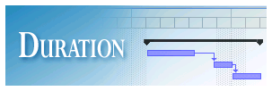


Project Scheduling in MS Project
Scheduling Formula
Duration
Elapsed time a task will take, usually measured in days
E.g. Two days to test a system
Work
Total number of hours to complete a task
E.g. Completing a system test takes 8 hours
Resource Unit
Number of resources and/or percentage time that is assigned to a task
E.g. Tester will devote 50% of time to system test.

Slide 23
Project Scheduling in MS Project
Scheduling Formula Example
Duration = Work ÷ Resource Units
Example:
Duration (16 hours or 2 days) =
Work (8 hours of effort) ÷
Resource Units (0.5 of a person’s time)

Slide 24
Task Types in Microsoft Project
Fixed Unit Task (default)
A task in which the assigned unit is a fixed value.
Resource assignment units in Project are expressed either in percentages or decimals. At 100% units, a resource is working full-time; at 50% units, the resource is working half-time, and so on.

Slide 25
Task Types in Microsoft Project
Fixed Unit Task Example
You assign 1 painter full-time (100%) to paint walls in 4 days (the duration). The work (the time it will take the painter to complete the task at 100% effort) is 32 hours, or 4 days.
If you increase the amount of work to 40 hours, Project recalculates the duration as 5 days. Now the painter has an extra day of work on the task.

Slide 26
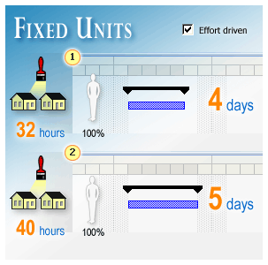
Task Types in Microsoft Project

Slide 27
Task Types in Microsoft Project
Fixed Duration Task
The duration for a task remains the same regardless of the number of resources assigned to it.
Estimate how many days you have to complete the task and calculate the others based on this number.

Slide 28
Task Types in Microsoft Project
Fixed Duration Task Example
Your painter is assigned full-time (100%) to paint a room in 4 days. The work is 32 hours.
Then you assign the same painter another room to paint, but he has another job in 4 days, so the painter can only work part-time (50%) painting the room.
When you enter 50%, Project keeps the duration fixed at 4 days, and recalculates work to be 16 hours.

Slide 29
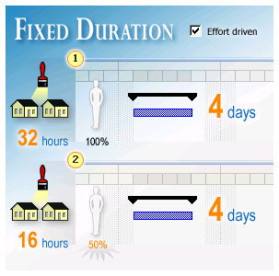
Task Types in Microsoft Project

Slide 30
Task Types in Microsoft Project
Fixed Work Task
The amount of work is a fixed value.
Changes to the task duration or the number of assigned units (or resources) don’t impact the work.
Estimate time for task and then add the number of resources; duration is calculated.

Slide 31
Task Types in Microsoft Project
Fixed Work Task Example
Two painters are assigned full-time (100%) to paint the walls in 2 days (work equals 32 hours or 16 hours per painter).
If you increase the duration of the task from 2 days to 4 days, Project sets each painter's assignment units to 50% so that each painter works only half-time and work remains constant at 32 hours.

Slide 32
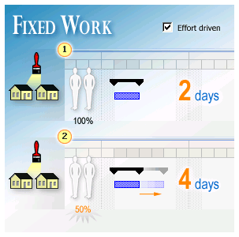
Task Types in Microsoft Project

Slide 33
Effort-Driven Scheduling
Effort-driven (default)
Duration of a task shortens or lengthens as resources are added or removed, while amount of effort necessary remains unchanged.
“Keep the work constant”
Not effort driven
Duration of task will remain the same

Slide 34
Special Tasks
Milestones
Important dates in schedule with a significant event occurring
Have 0 duration; it is an event or a point in time
Name as <deliverable><past tense> e.g. module complete, other words: delivered, accepted, done, shipped, finished

Slide 35
Timeboxing
Allocates a fixed time period, called a time box
Make deadline possible
Set by development group
Reduced functionality as necessary
Fewer “finishing touches”
Geared to RAD and Agile development
Notes:
Follows 80/20 rule (20% of the functionality used 80% of the time)
80% of the system can be provided in 20% of the time

Slide 36
Timeboxing Steps
1. Set the date for system delivery.
2. Prioritize the functionality that needs to be included in the system.
3. Build the core of the system (the functionality ranked as most important).
4. Postpone functionality that cannot be provided within the time frame.
5. Deliver the system with core functionality.
6. Repeat steps 3 through 5, to add refinements and enhancements.

